Slide 1
iSKKUBot
RAG-based Multilingual Chatbot for Exchange Students at SKKU
Notes:
We’re topic is iSKKUBot, a RAG-based Multilingual Chatbot for Exchange Students at SKKU.

Slide 2

EQUIPO SASHIMI
GeonWoo Bang
JeongYoon Hwang
Jiae Choi
Mikel Larrarte Rodriguez
Notes:
And this is our team EQUIPO SASHIMI.

Slide 3
Table of contents.
01
Progress
What have we done & What will be done next.
02
Technical Background
Background of our project (RAG)
03
RAG
Progress implementing RAG.
04
Scraping
Progress scraping the web.
Notes:
Today's presentation will cover the following topics.

Slide 4
Progress
01
What have we done? Where are we?
Notes:
efore diving into the main content, let’s first take a look our project progress, What have we done and where we are.

Slide 5
Timeline
 | Week 6 | Week 7 | Week 8 | Week 9 | Week 10 | Week 11 | Week 12 | Week 13 | Week 14 | Week 15
Scrap form Web/PDF
Construct Database |  | done
Implement RAG(Retriever) |  |  | In progress
Implement RAG(Generator) |  | In progress
Evaluate
Implement Back-end
Implement Front-end
done
Notes:
The current timeline is as follows.
today is week 7, so we finished scrap from web, pdf and constructing external database.
We’ve been working hard on implementing RAG, and it’s partially completed.

Slide 6
Progress
1. Scraping & Constructing Database
- Jiae, Jungyoon
2. Implementing RAG
Mikel (Retrieval)
Geonwoo (Generation)
Notes:
Jiae and Jungyoon from our team are responsible for data-related scraping and database construction, while Mikel and I have divided the tasks of implementing the Retriever and Generator for the RAG system.

Slide 7
Technical Background
02
Technical Background of RAG
Notes:
First, Let’s begin with the technical background.

Slide 8
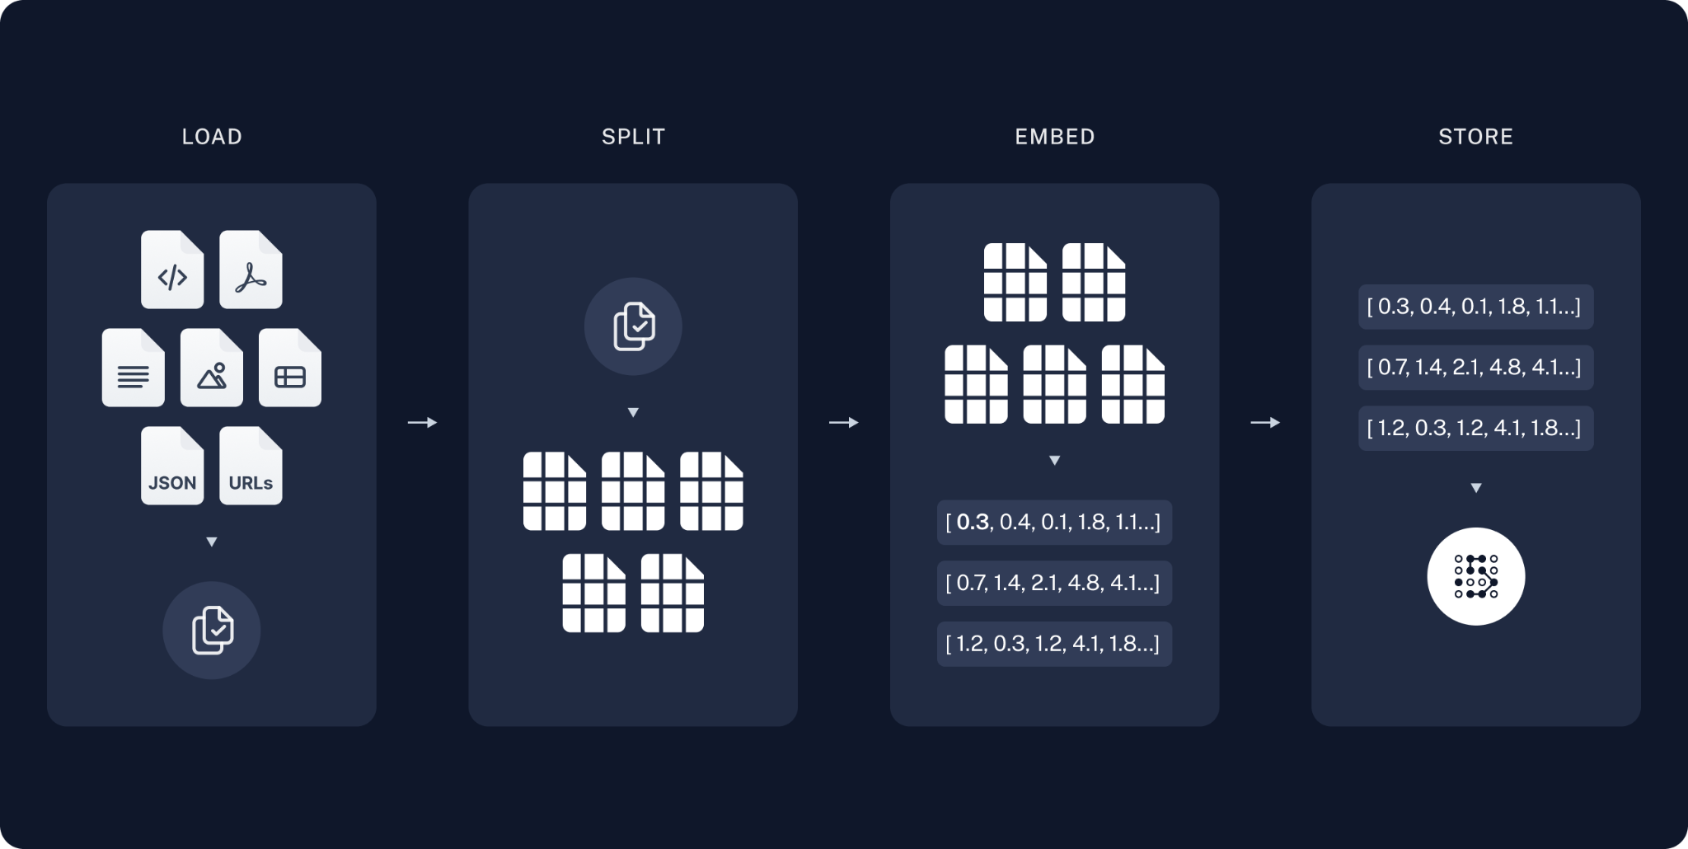
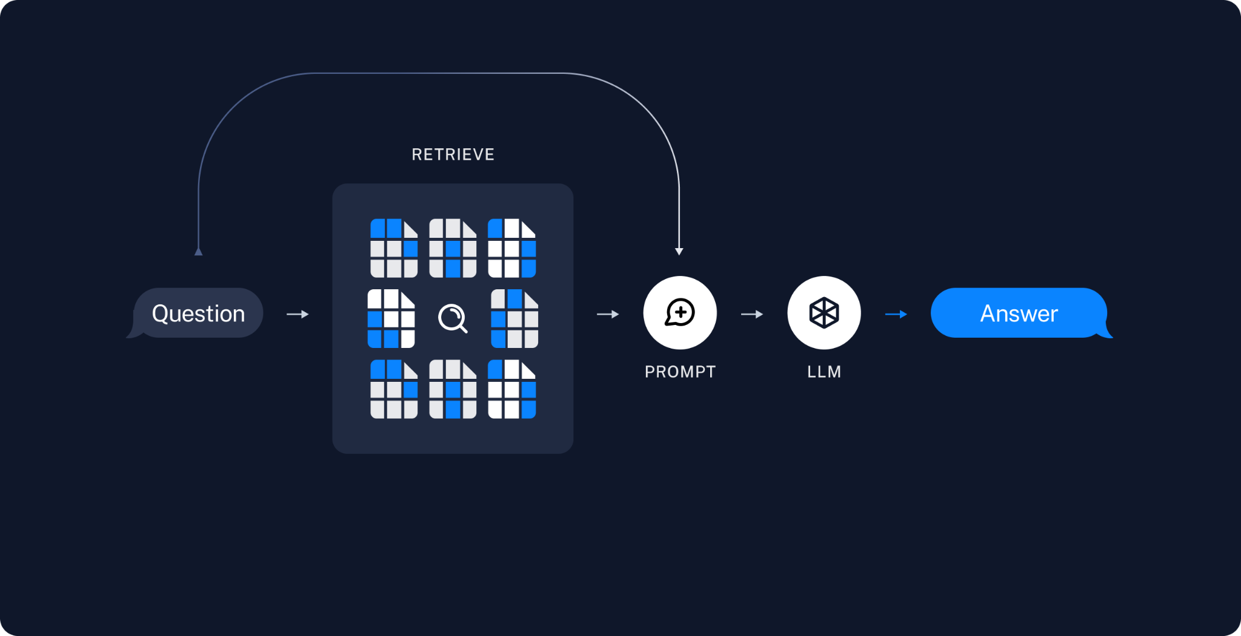
Technical Background
RAG applications have two stages:
Indexing stage: Pipeline for obtaining data from source and indexing.
Query stage: Actual RAG chain → Takes user’s real-time query and retrieves relevant data from the index (Retriever) + passes to the model (Generator).
Notes:
As mentioned in the previous proposal, we plan to use RAG to build a chatbot for exchange students.
To fully implement RAG, we need to go through two key stages.
The first stage is indexing. Indexing is the stage where we prepare the knowledge base. In this phase, we extract and refine data from external sources and load the indexes into the database.
Next is Query stage. The query stage is actual RAG chain. it covers the entire process of retrieves relevant data based on the query from the index, redefining the prompt with the extracted context, and then passes it to the model.

Slide 9
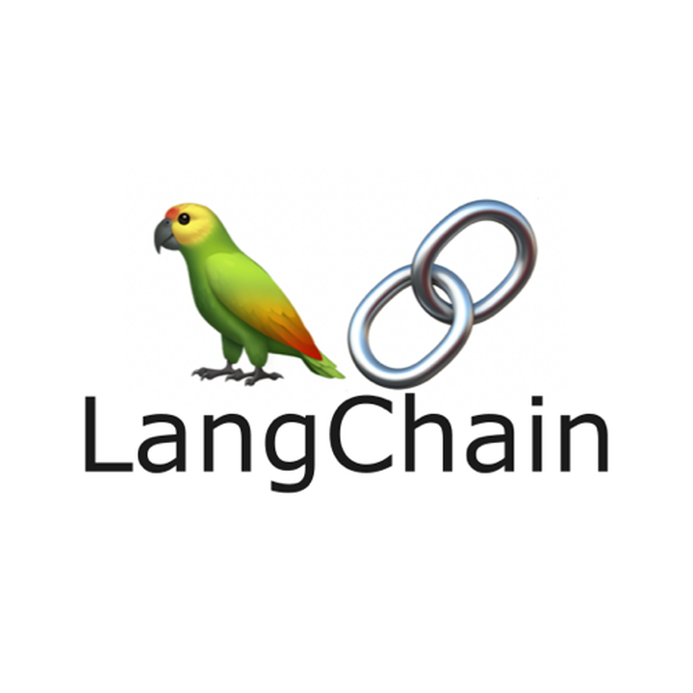
Technical Background
Indexing stage:
Load: Use Document Loader to load our data.
PDFs → PyPDFLoader
Web → WebBaseLoader
Split: Use Text Splitters to divide large Documents into smaller chunks.
CharacterTextSplitter
Store: Place to store & index our splits.
HuggingFaceEmedding
Vector Stores: Pinecone, Chroma, …
Notes:
Let’s take a closer look. The indexing stage can be divided into three steps: load, split, and store. First, since we decided to build the RAG database based on PDFs and web sources, we considered using tools like PyPDFLoader and WebBaseLoader. Next, we use the CharacterTextSplitter from the Langchain module to split large text data into manageable chunks. Finally, the split texts are embedded and stored in an external vector database. Through this indexing stage, we can establish a rich and reliable database that will be utilized by the RAG model.

Slide 10
Technical Background
Query Stage:
Retrieve: Given a user input → retrieve relevant splits from storage using a RetrievalQA.
Generate: ChatModel / LLM → produce an answer using a prompt that includes the question + the retrieved data.
Notes:
In the Query Stage, we can leverage Langchain modules to streamline the query processing. Based on the user’s input query, we use RetrievalQA to retrieve relevant splits from storage. Then, the extracted context is passed to the Generator, which produces an answer by using a prompt that includes both the question and the retrieved data.

Slide 11
RAG
03
Retrieval Augmented Generation
Notes:
Now, let's review what we have implemented so far. First, we’re gonna talk about implemented RAG parts by mikel and me.

Slide 12

RAG - Retriever
Researched about different options:
FAISS (Facebook AI Similarity Search) Vector Store:
Used in our first demo.
Pinecone Vector Store:
Started testing with dummy index.
MultiQueryRetriever:
Automatic prompt tuning using an LLM to generate multiple queries for a given user input query.
Useful when original query needs info about multiple topics.
Allows usage of Pinecone Vector Store.
Notes:
We searched about may options to improve our retrieve ability. First, we considered both the FAISS vector store and Pinecone vector store from the perspective of vector storage. However, since FAISS requires a local database and needs to be processed within server, we decided to use Pinecone, which better fits the limitations of our project in terms of database management.
Additionally, to retrieve context from multiple perspectives, we decided to implement the MultiQueryRetriever. The MultiQueryRetriever automatically tunes prompts using an LLM to generate multiple queries based on a single user input query. This allows us to cover a wider range of questions and extract more relevant context. However, this part is still under development and is expected to be completed by next week.

Slide 13
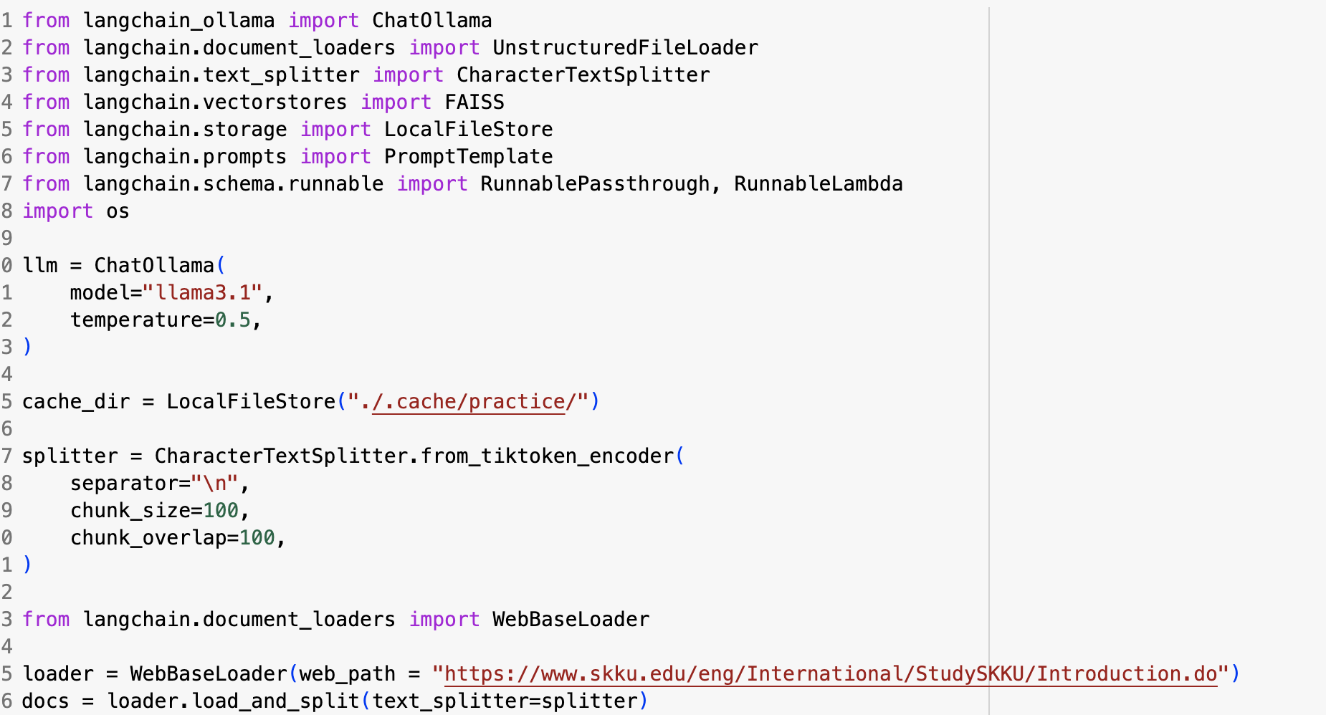
RAG – Generator
Basic Langchain-Ollama demo test
Using Basic Llama-3.1 8b
Use basic Local Storage (connection to external database will be done next week)
Exchange Student’s Introduction
page was used for demo
Notes:
We have also implemented a demo for the generator part. We connected the Llama-3.1-8B model, provided by Ollama, with Langchain. Although the connection to the external database has not been completed yet, we used a basic local database to attempt RAG implementation on a few documents for initial testing. also, we used huggingfaceEmbedding to make index for our database.

Slide 14
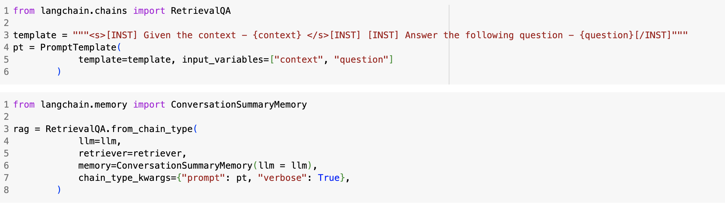
RAG – Generator
Basic Langchain-Ollama demo test
Use cosine similarity search
Use Langchain’s Retrieval QA Module
Notes:
then, we used cosine similarity search to find out the relevant retriever based on our embeddings. the final query is given to RetrievalQA, which is efficient module from langchain for finding query and applying it to our prompt. additionally, we used ConversationSummaryMemory to store chat caches for implementing multiturn chatbot.

Slide 15
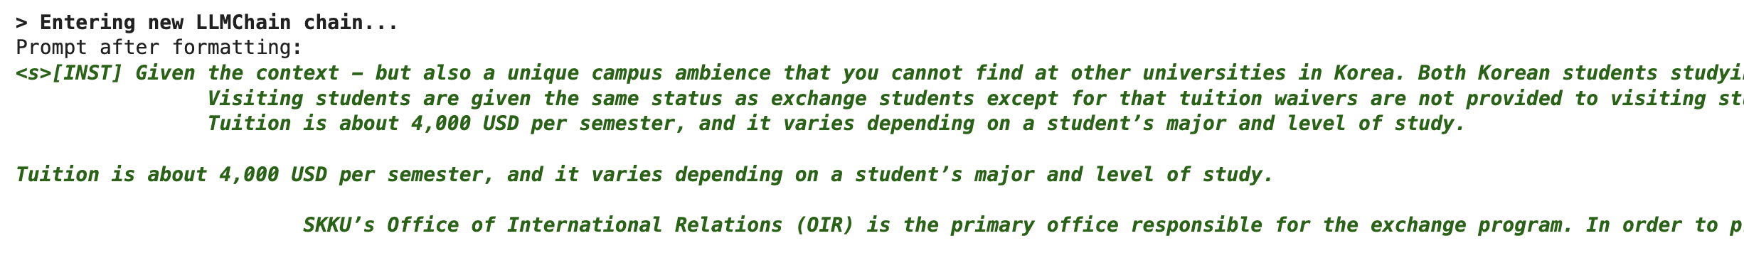
RAG – Generator
Demo Results
Successful Context Extraction
Appropriate response based on given context
Notes:
As a demo result, We confirmed that successful context extraction was achieved. and Also, based on this given context, we verified that appropriate responses were generated.

Slide 16
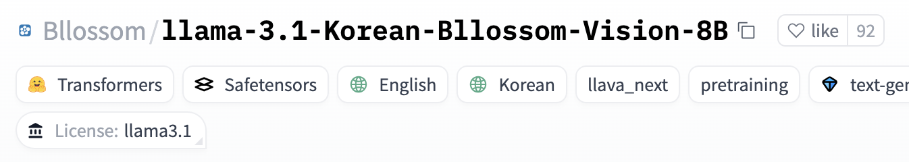
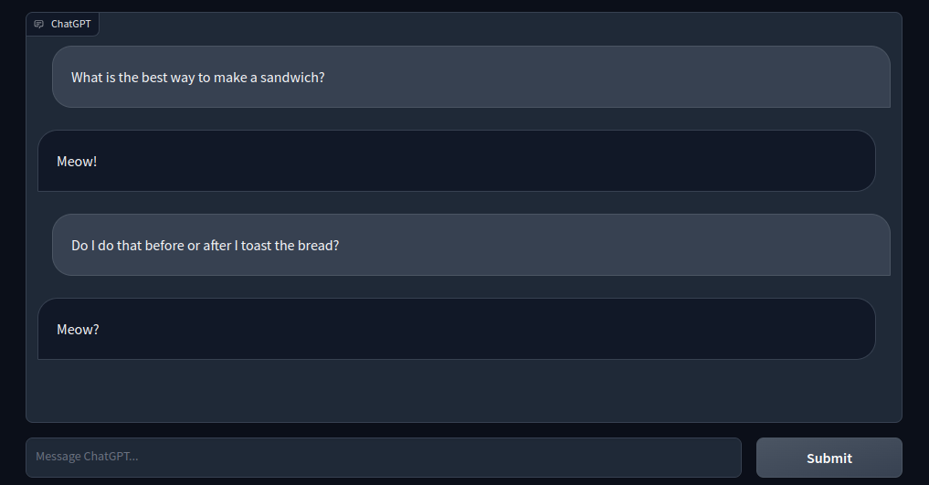

RAG – Generator
Areas for Improvement
Bilingual(English, Korean) should be used to understand Korean context – On Progress
UI/UX with Gradio – On Progress
Notes:
Except the parts still in development that I mentioned earlier, our top priority is to switch from the default Ollama model to a bilingual Korean-English model. We also plan to use Gradio to create a chatbot with a user-friendly UI/UX.

Slide 17

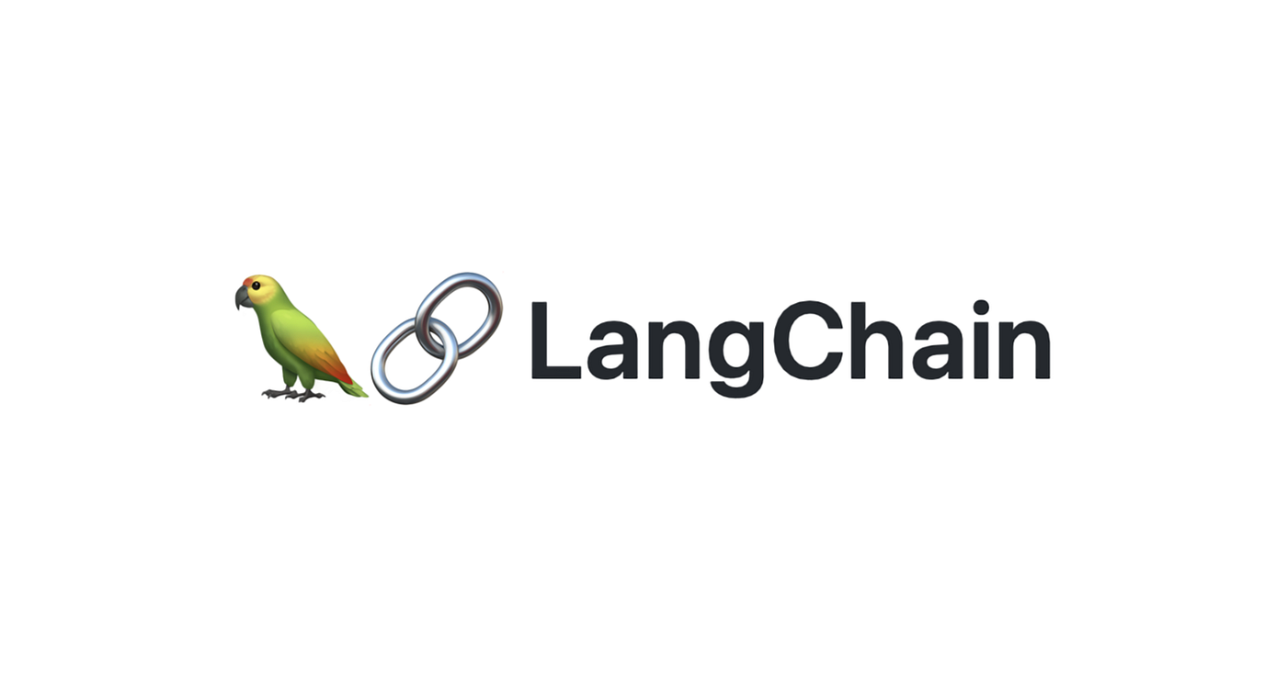
RAG
Areas for Improvement
External vector database – Langchain Connection – On progress
Notes:
And we are also on progress for connecting pinecone and langchain.

Slide 18
RAG
Evaluation:
Human evaluation:
Ask a group of people questions about overall performance of the system.
LLM-as-a-judge:
Synthetic evaluation dataset (QA pairs) generated by LLM.
Questions will be filtered out by other LLM based on some criteria:
Groundedness: Can the question be answered from the given context?
Relevance: Is the question relevant to users?
LLM-as-a-judge agent → perform the evaluation on the synthetic dataset.
Notes:
We are considering two options for evaluation. The first is human evaluation. Since Mikel has many exchange student friends, we thought it would be a good option to ask a group of people about the overall performance of the system.
The next method is using LLM as a judge. We are planning to generate a synthetic evaluation dataset (QA pairs) with an LLM. After that, we can provide the queries and our model's responses to another LLM for evaluation, considering factors like groundedness and relevance. This approach is widely used and highly correlated with human responses, thanks to the development of automated scoring systems like G-Eval.

Slide 19
Scraping
04
Scraping and constructing database
Notes:
Let’s continue by taking a look at the scraping part.

Slide 20
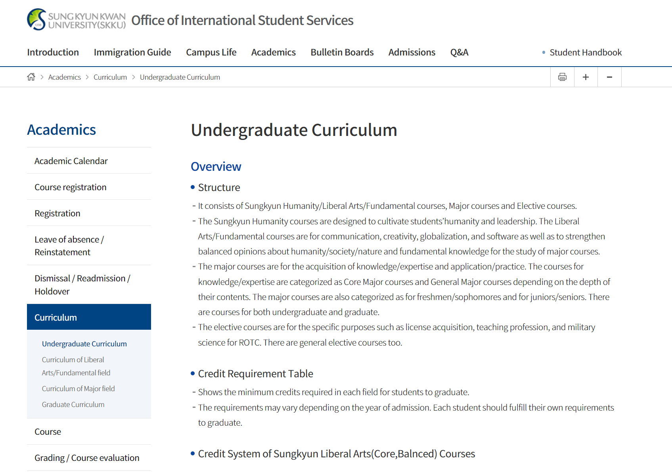
Scraping
Scraping web data using WebBaseLoader from LangChain.
SKKU homepage.
Office of International Student Services.
SKKLUB(Webpage not responding).
It consists of Sungkyun Humanity/Liberal Arts/Fundamental courses, Major courses and Elective courses.
The Sungkyun Humanity courses are designed to cultivate students’humanity and leadership. The Liberal Arts/Fundamental courses are for communication, creativity, globalization, and software as well as to strengthen balanced opinions about humanity/society/nature and fundamental knowledge for the study of major courses.
The major courses are for the acquisition of knowledge/expertise and application/practice. The courses for knowledge/expertise are categorized as Core Major courses and General Major courses depending on the depth of their contents. The major courses are also categorized as for freshmen/sophomores and for juniors/seniors. There are courses for both undergraduate and graduate.
The elective courses are for the specific purposes such as license acquisition, teaching profession, and military science for ROTC. There are general elective courses too.
…
WebBaseLoader
Notes:
We scrap data from webpages and pdfs relevant to skku. We’ve utilized WebBaseLoader from langchain to scrap web data. The webpage we scraped are, SKKU homepage, office of international student services, and skklub. and of course, We also plan to include a wider variety of documents.

Slide 21
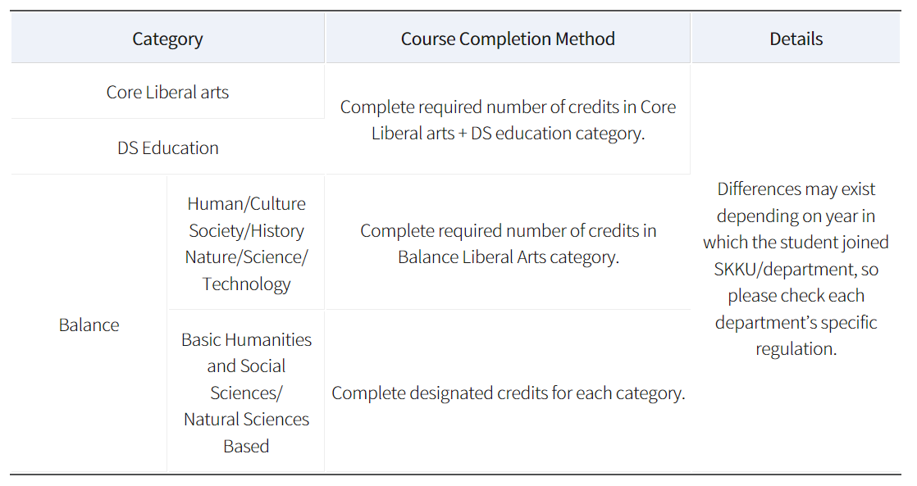
Scraping
Cleaning the scraped data:
Irrelevant data.
Line breaks, white spaces, tabs.
Encoding issues like "�" symbols.
Table data(working in progress).
Notes:
However the scraped data has following problems. 1) It contains irrelevant information such as header and footer, but we only want the main content. 2) Line breaks, white spaces, tabs are not organized properly.
3) Some characters are not encoded properly.
4) Data in table format is not scraped properly.
We took cleaning process to address these problems, however we are still working on how to store table data scraped from the web.

Slide 22
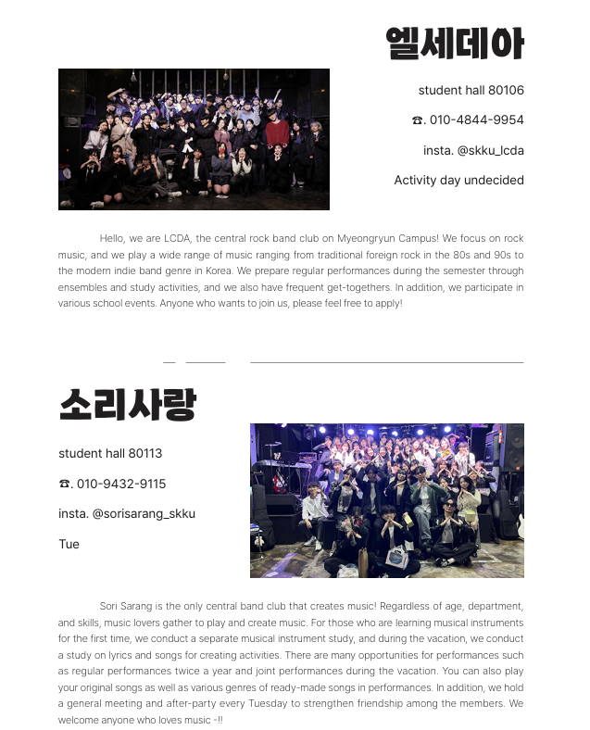
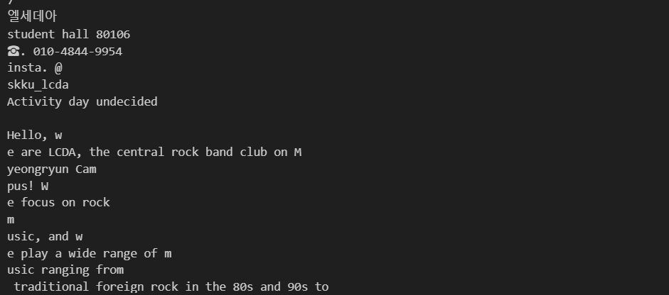
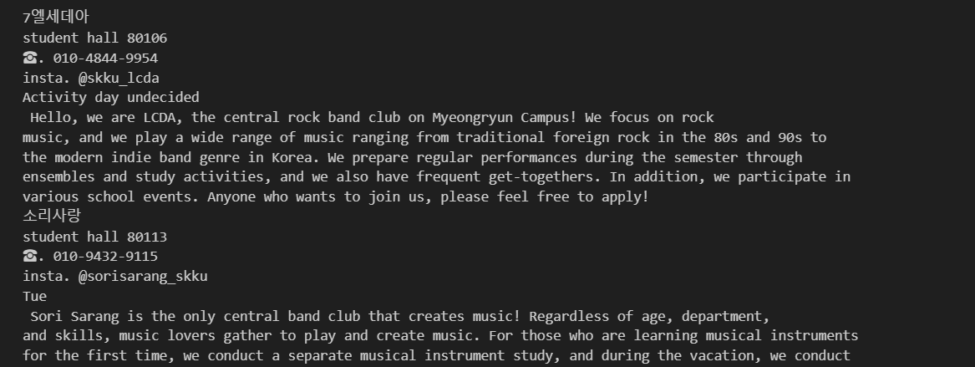
Scraping
Scraping PDF data using PyPDFLoader from LangChain.
Used data: 2024 SKKU Club Guidebook, 2024 international student handbook
Trials
: PyMuPDFLoader, fitz
Wrong
format!
Selected method
: PyPDFLoader
Expected Format :)
Notes:
We’ve Tried some method to improve PDF text extracting performance.
In our experiment, PyMuPDFLoader, fitz are faster than PyPDFLoader, but they returned wrong format.
We need a text in a good format for RAG to understand the context better than shortening the time. So we chose PyPDFLoader for PDF text extraction.

Slide 23

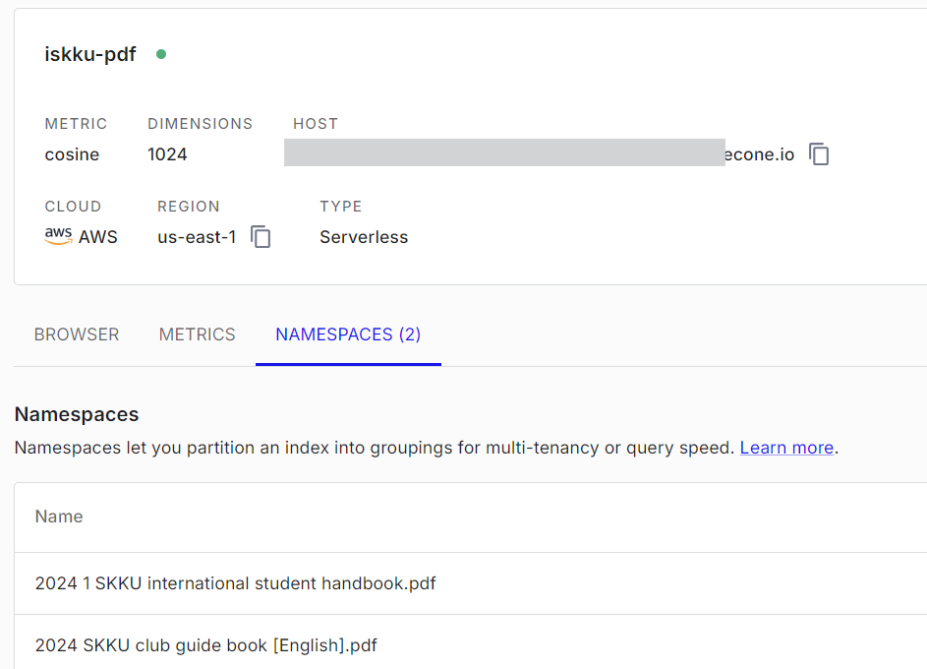
Database
Scraping results
(text)
Text split
(chunk_size 1000, chunk overlap 200)
embedding
(multilingual-e5-large-instruct)
Store in Pinecone
Notes:
Stored text data follows these steps:
Preparing text data, Spliting text into chunks, Embedding chunks, Storing chunks and embeddings in pinecone
We setted chunk size to 1000, chunk overlap 200 and chose multilingual e5 large from huggingface for embedding model.

Slide 24
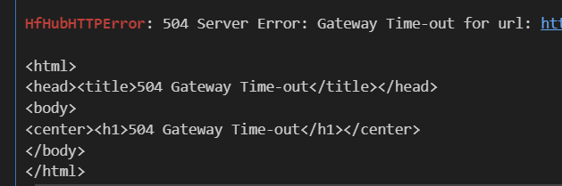
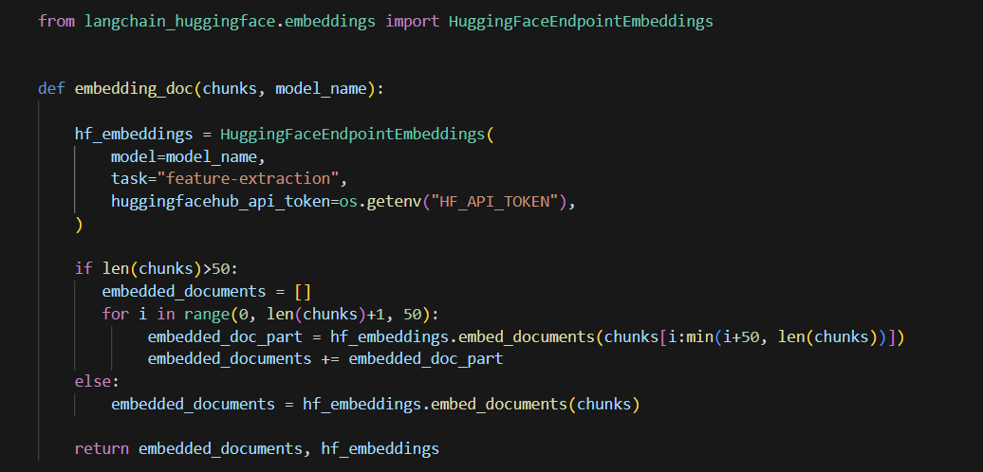
Database - Troubleshooting
Error
Solution
504 Server Error: Gateway Time-out
cause
Divide chunk List into 50 chunks and pass them to the embedding model.
Chunk List size is too large!
(Because some PDFs are over 160 pages)
Notes:
However, We faced some errors while embedding chunks.
We got server error and it was because chunk list size is too large.
Some of our PDFs are over 160 pages.
So we tried to divide chunk list into 50 chunks and passes it to the embedding model.
And it worked!
Through these different attempts, we've managed to build an external vector database for the RAG-based chatbot aimed at helping exchange students.

Slide 25
Next Tasks
05
What is the plan for the following weeks?
Notes:
Now, we’ve come to the final part. Let’s take a look at our next steps.

Slide 26

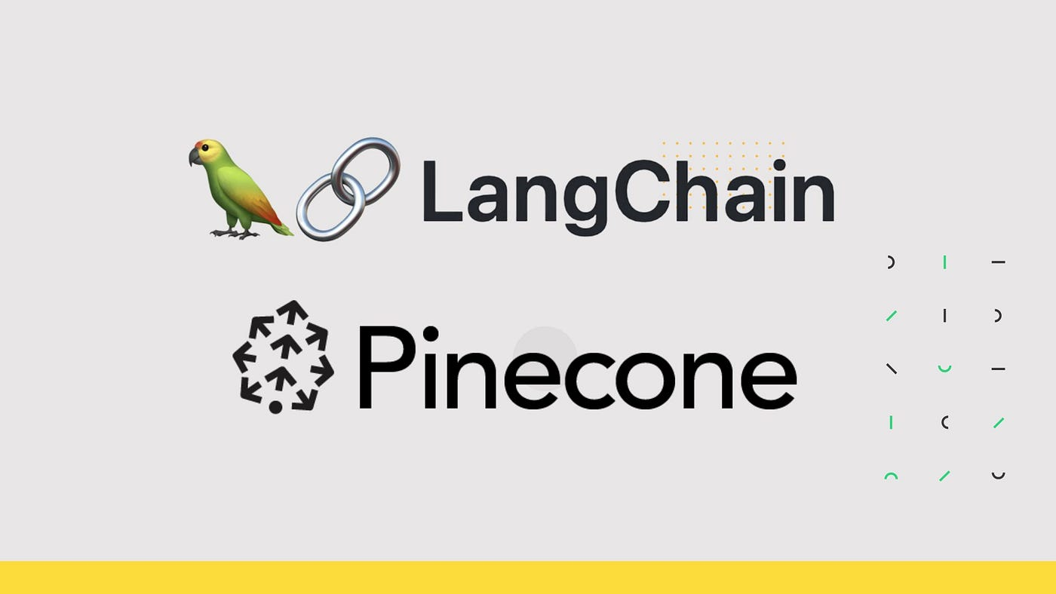
Next Tasks
Optimal Generator Model Selection & Adjustment.
Connecting Pinecone - Langchain.
Processing table content on RAG document.
Prompt Engineering & Hyperparameter Setting.
Preparing evaluation set.
Notes:
we are planning to do this five steps after this class.
first, we are going to select and adjust optimal generator model.
second, we are going to connect pinecone with langchain.
third, we are going to process table content on RAG document.
fourth, we are going to do prompt engineering, and hyperparameter setting.
finally, we are preparing synthetic evaluation set for our evaluaion.

Slide 27
References
Rag evaluation - hugging face open-source AI Cookbook RAG Evaluation - Hugging Face. Available at: https://huggingface.co/learn/cookbook/rag_evaluation
Rest meets react: Self-improvement for multi-step reasoning LLM agent Paper page. Available at: https://huggingface.co/papers/2312.10003
Pinecone 🦜️🔗 LangChain. Available at: https://python.langchain.com/docs/integrations/vectorstores/pinecone/
Conceptual guide 🦜️🔗 LangChain. Available at: https://python.langchain.com/docs/concepts/
Retrievers 🦜️🔗 LangChain. Available at: https://python.langchain.com/v0.1/docs/integrations/retrievers/
Vector Stores 🦜️🔗 LangChain. Available at: https://python.langchain.com/v0.1/docs/modules/data_connection/vectorstores/
Notes:
And this is our references.

Slide 28
Thank you!
Do you have any questions?

